Slide 1
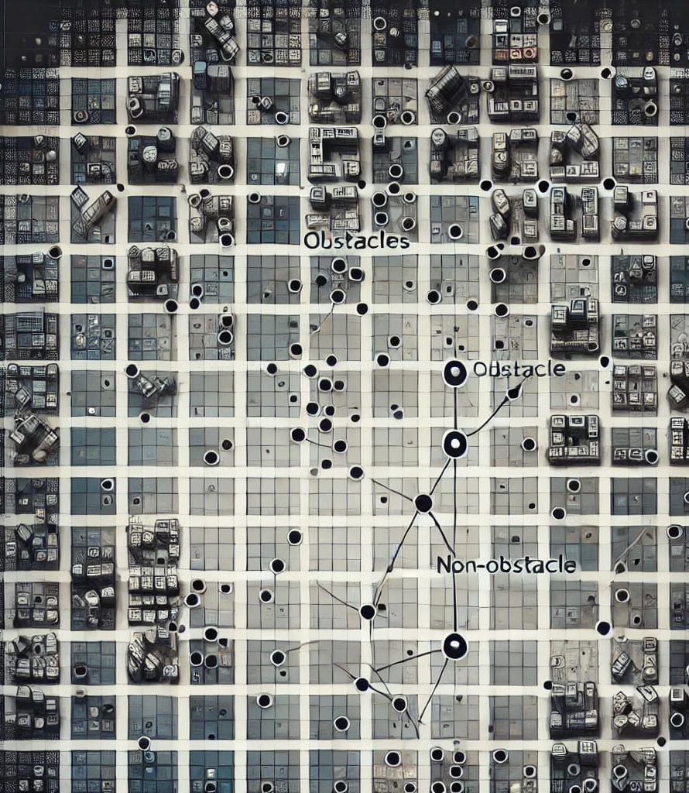
Visibility Learning

Slide 2
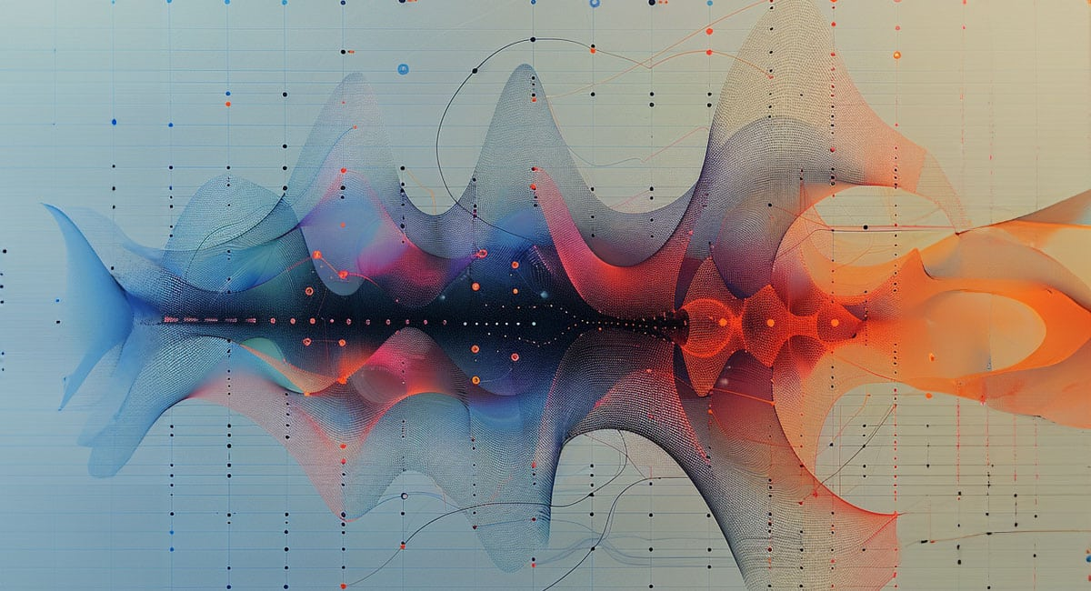
RNN based architecture

Slide 3
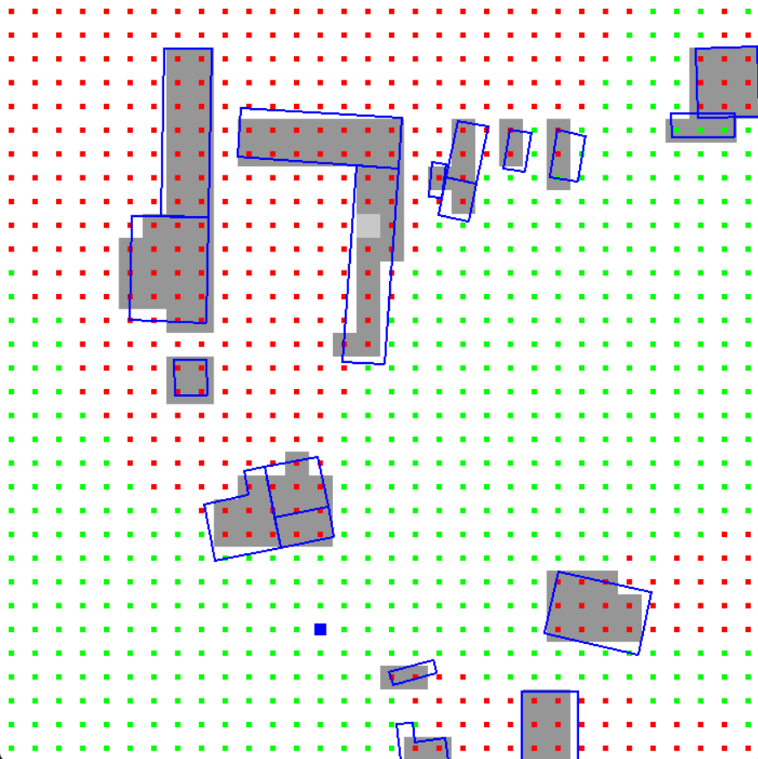
RNN based architecture
Motivation:
In our current implementation, we predict visibility between some fixed cells.
Not between any two continuous points

Slide 4
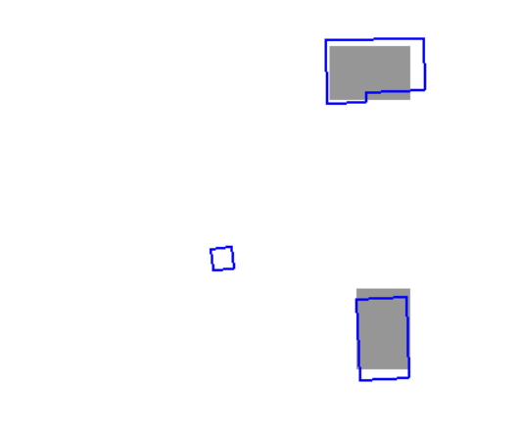
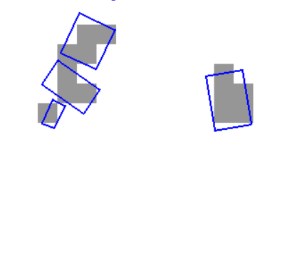
RNN based architecture
Motivation:
Scan conversion loses accuracy
Doesn’t create embedding for obstacles smaller than cell
Incorrectly labels visibility in dataset (in our approach of dataset generation)

Slide 5
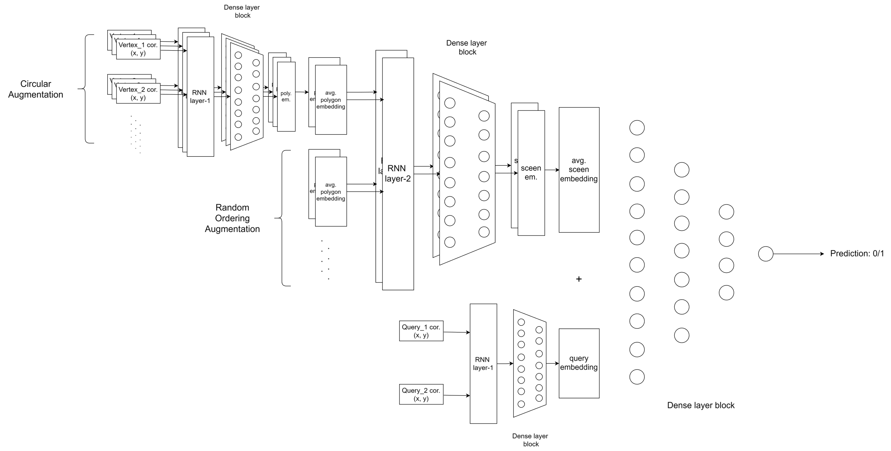
RNN based architecture

Slide 6
RNN based architecture
Testing: 3961 independent scenes, 500 query points per scene
Training: 3569 scenes, 500 query pairs per scene, 15 epoch | Training: 6169 scenes, 500 query pairs per scene, 6 epoch
Test Loss: 0.3205 Test Accuracy: 0.8556 Test Precision: 0.8971 Test Recall: 0.8475 Test Specificity: 0.8668 Test F1: 0.8716 | Test Loss: 0.3202 Test Accuracy: 0.8567 Test Precision: 0.9138 Test Recall: 0.8305 Test Specificity: 0.8926 Test F1: 0.8702

